Slide 1

NRF24L01 module

Slide 2

Why nrf 24L01?

Slide 3
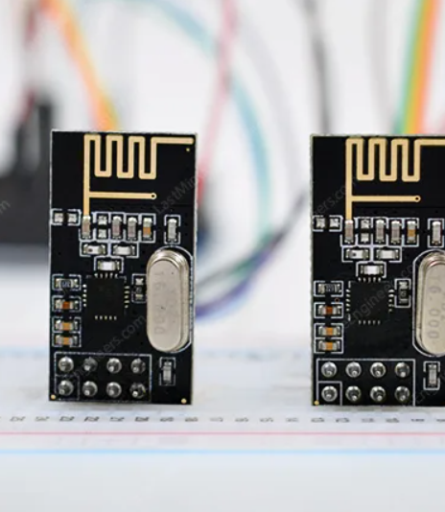
1-transceiver module
2-The nRF24L01 module is available for less than two dollars
3-uses GFSK modulation for data transmission
4-The data transfer rate is configurable and 5-can be set to 250kbps, 1Mbps, or 2Mbps
6-voltage ranges from 1.9 to 3.9V
7-the module consumes only 12 mA during transmission
8-And the best part is that it consumes only 26 µA in standby mode and 900 nA in power down mode.
9-Communication Range800+ m (line of sight)

Slide 4
Spi interface

Slide 5
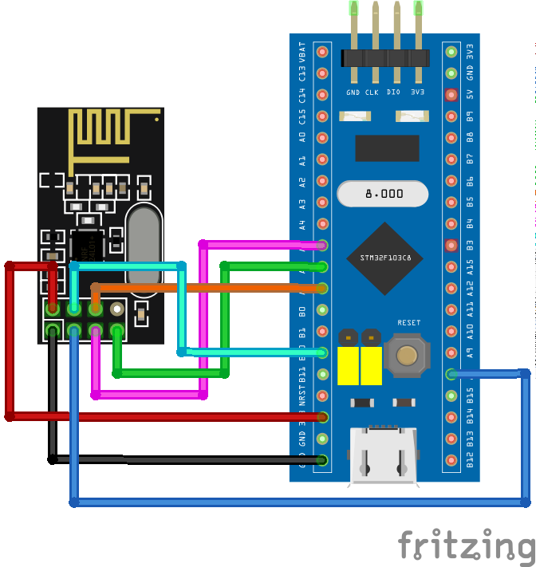

Slide 6
How does the nRF24L01+ module work?
The nRF24L01+ module transmits and receives data on a specific frequency known as a channel.
This channel can have any frequency between 2.400 and 2.525 GHz (2400 to 2525 MHz).
Each channel takes up less than 1 MHz of bandwidth. This gives us 125 possible channels with a 1MHz spacing.
can operate on 125 different channels, allowing you to build a network of 125 independently operating modems in one location.

Slide 7
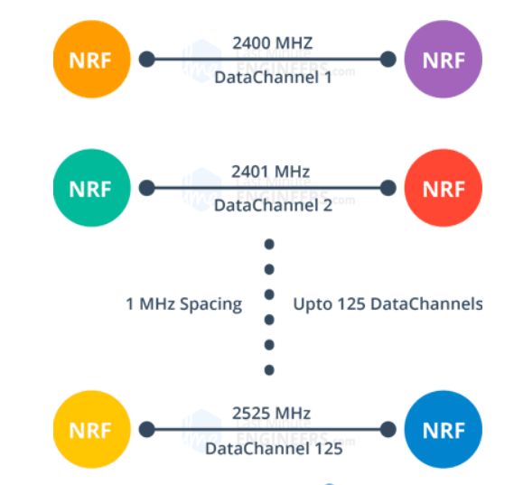

Slide 8
Automatic Packet Handling

Slide 13
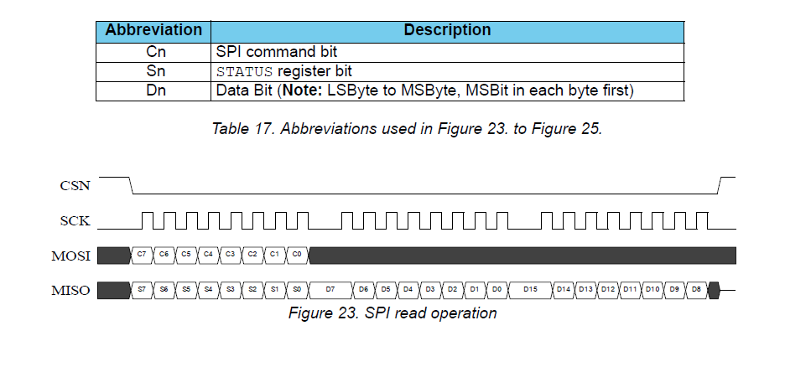
How stm32 deal with nrf24l01
Stm32 use Spi protocol to send a data frame to nrf24 it called a command
For example we need to read status register
So we will make the following :
1-stm32 apply on MOSI pin the command of reading operation followed by the register address
2-wait for nrf to get back the data from that register in the next cycles

Slide 14
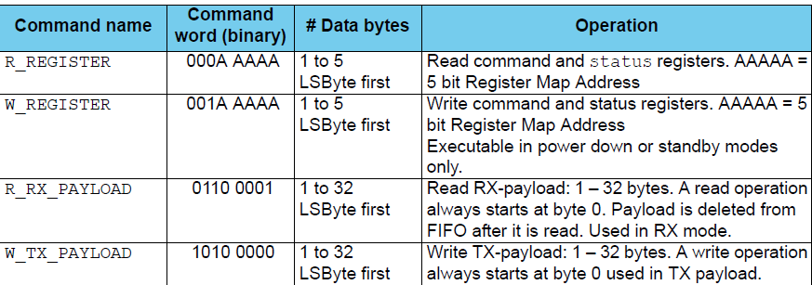
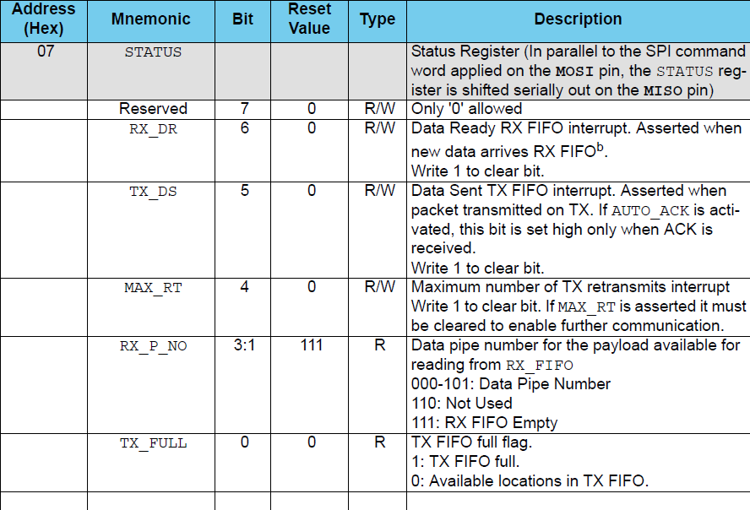
So, command will be: 0000 0111
MOSI = 0000 0111
MISO = DATA

Slide 15
Thank you

